Slide 1
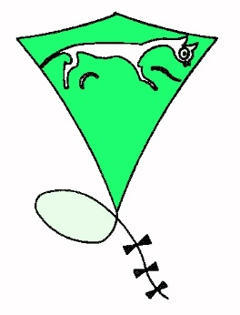
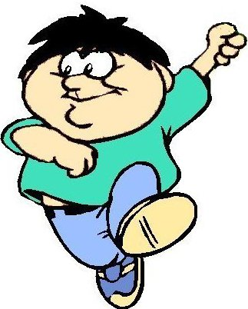
An introduction to kites
Prepared by
Arthur Dibble
Vice-president WHKF
arthur.dibble@ntlworld.com
www.tedberets.co.uk

Slide 2
History
Notes:
Kites are thought to have originated in China about 3000 years ago. One story is that a fisherman was out on a windy day and his hat blew away and got caught on his fishing line which was then blown up in to the air.
Bamboo was a ready source of straight sticks for spars and silk fabric was available to make a light covering, then in the 2nd century AD paper was invented and is still used to this day.

Slide 3
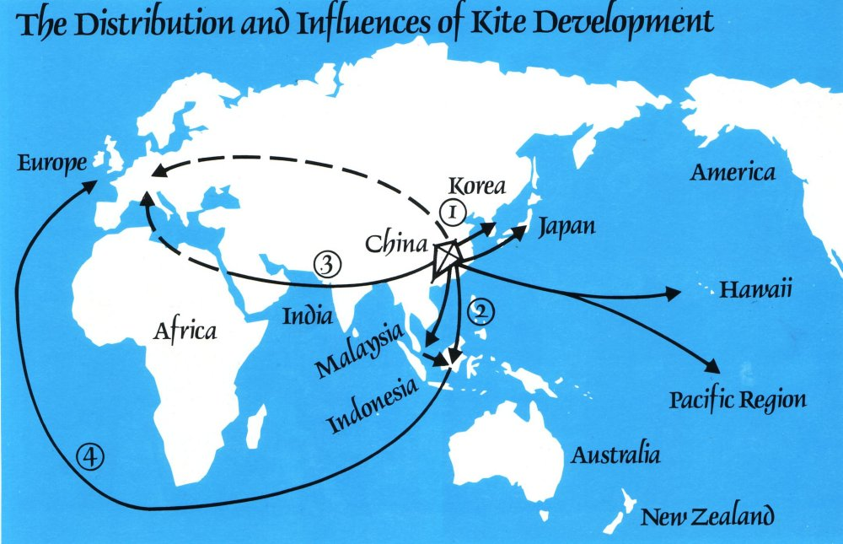
Notes:
From China kites spread to neighbouring countries and across the seas to the Pacific region. At the same time they spread across Burma, India and arriving in north Africa about 1500 years ago. They did not arrive in Europe or America until much later probably via the trade routes when these developed.

Slide 4
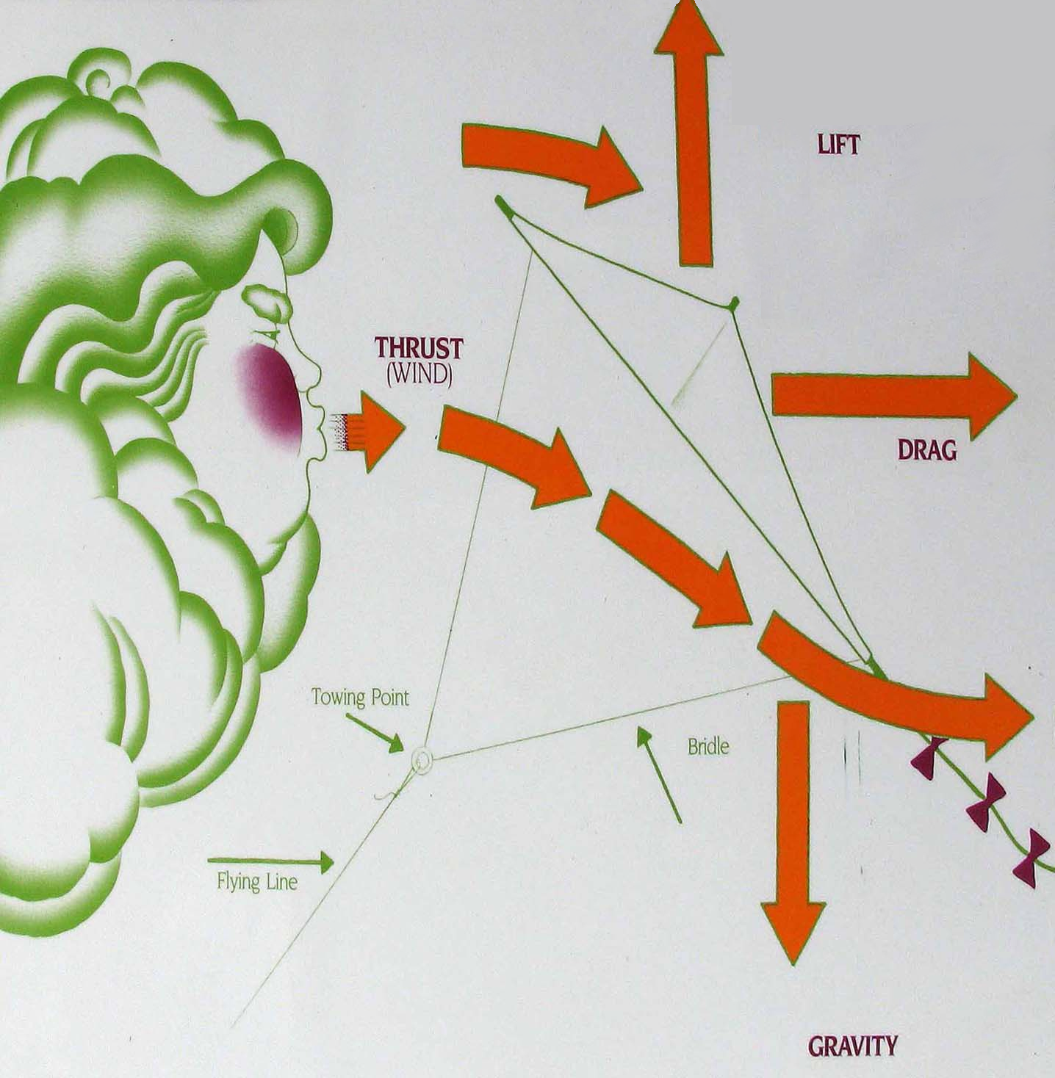
THE PHYSICS
Notes:
Kites fly when thrust, lift drag and gravity are balanced. The flying line and bridle hold the kite at an angle to the wind so that the air flows faster across the top than the bottom producing the lift.

Slide 5

The Parts of a kite
1 The Sail
This can be made of any material such as paper, fabric or plastic.
It is used to trap the air.
Notes:
The air must have some where to escape otherwise it spills over the front edge and makes the kite wobble. This can be done by using porous fabric or making it bend backwards to allow the air to slip smoothly over the side. Parachutes have a hole in the top to let the air through and this is used on kites such as sleds.

Slide 6
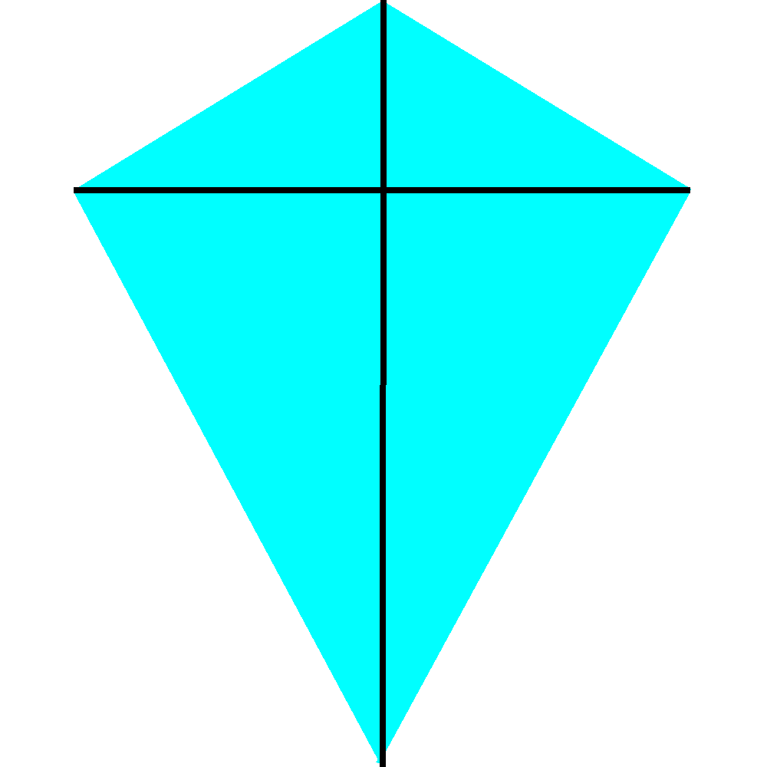
The Parts of a kite
2 The Spars (sticks)
These are used to hold the sail in shape.
They can be made from wood, metal or plastic.
Sometimes a tube of material is used and the wind inflates it.

Slide 7
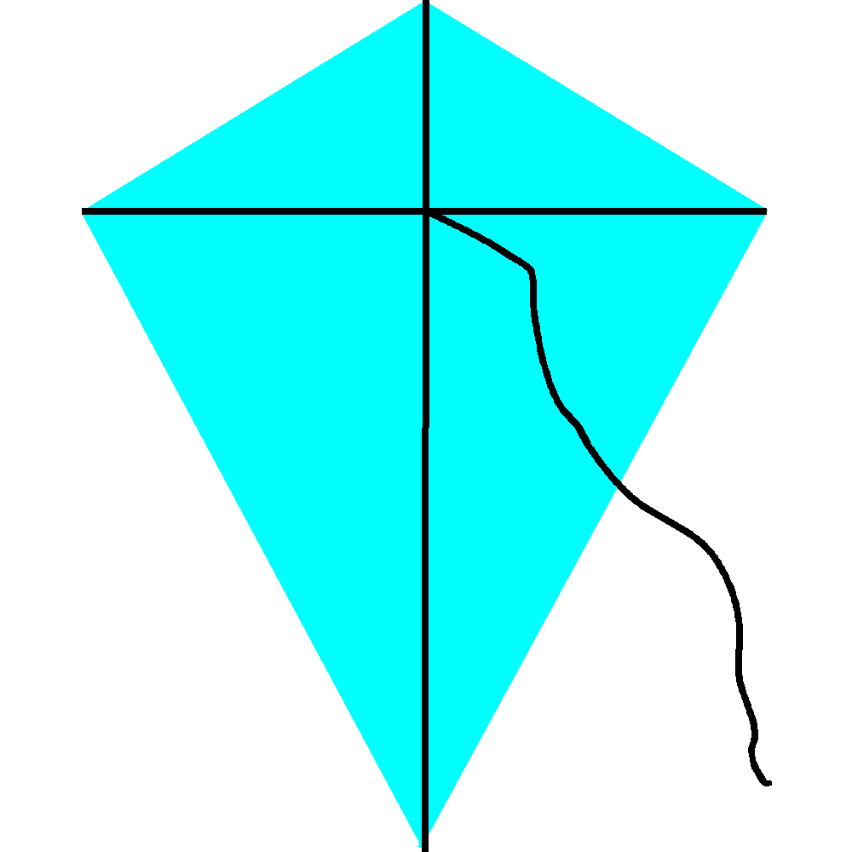
The Parts of a kite
3 The Flying line (string)
This stops the kite just blowing away.
It can be made from cotton, string, rope or even wire.

Slide 8
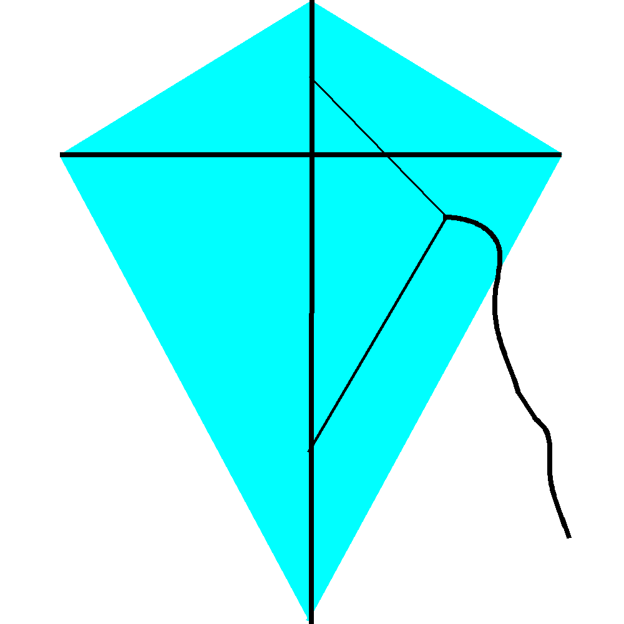
The Parts of a kite
4 The Bridle
This can be made from string or sometimes material.
It is used to hold the kite at the correct angle to the wind.

Slide 9
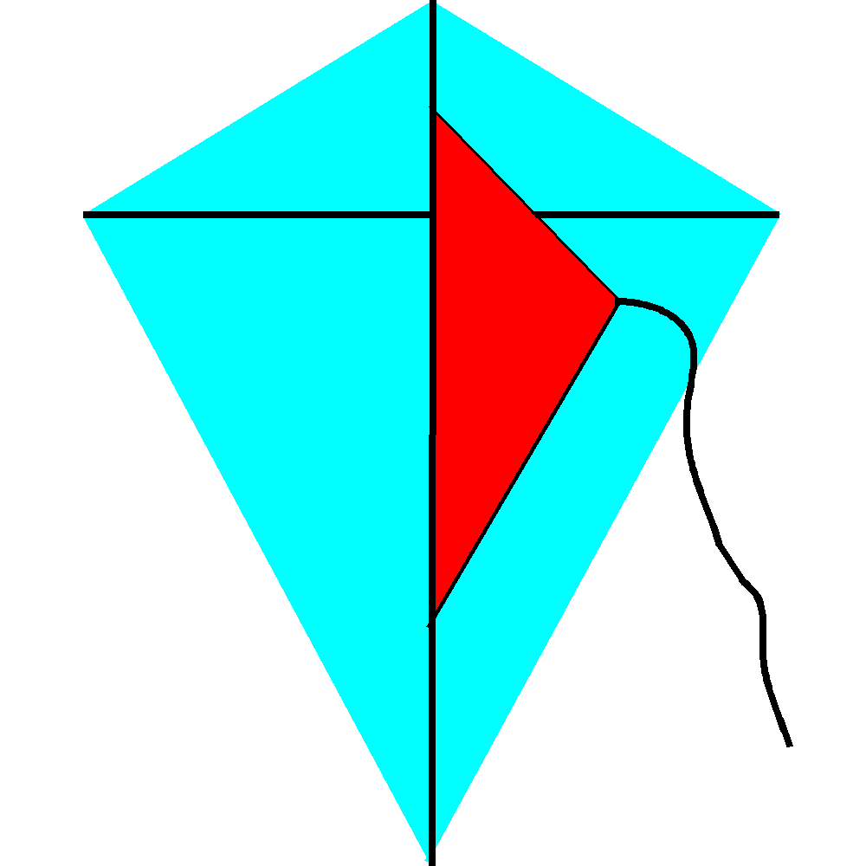
The Parts of a kite
5 The Keel
This is made from the same material as the sail.
It stops the kite going sideways and can also form the bridle.
Curving the kite backwards can have the same effect.

Slide 10
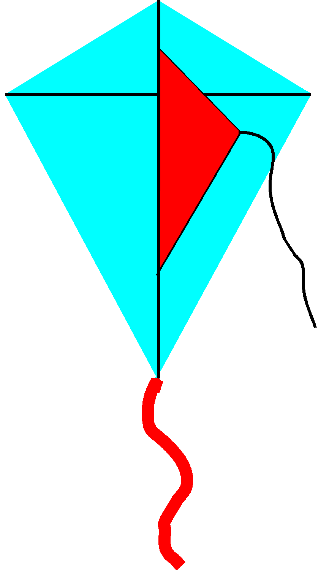
The Parts of a kite
6 The Tail
This can be made from anything.
They can be bows, ribbons or in many shapes.
The tail is not decoration but keeps the kite in line with the wind.

Slide 11
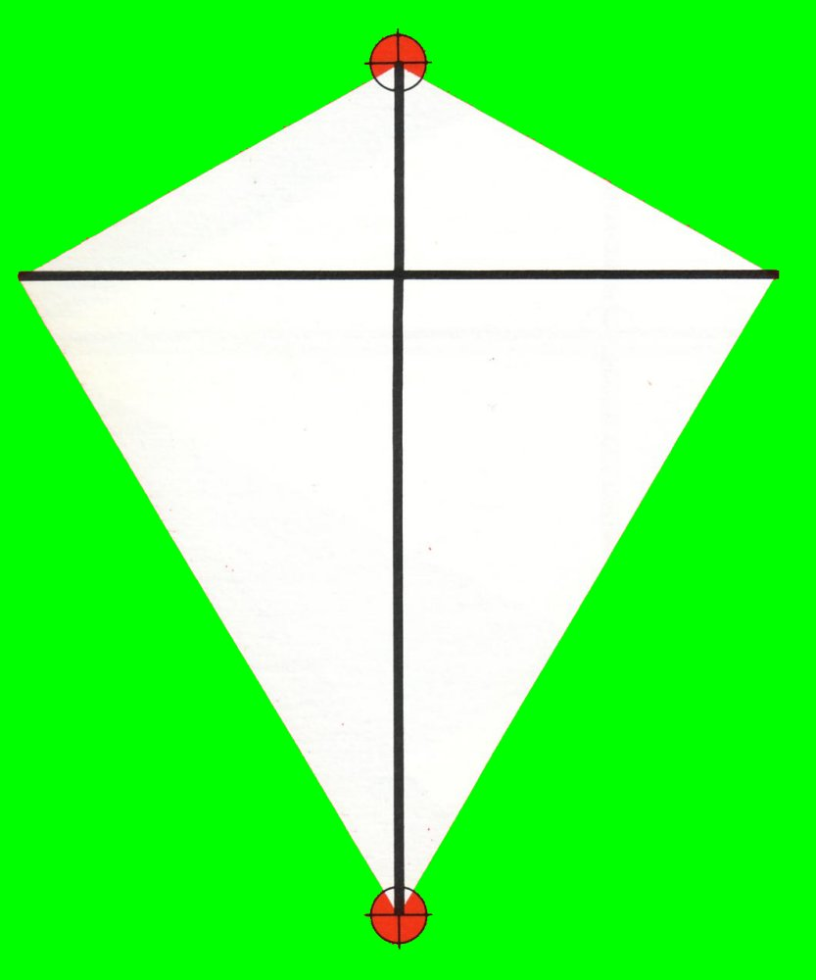
TYPES OF KITE
Notes:
There are many designs of kite but they are all variations of eight basic forms.

Slide 12
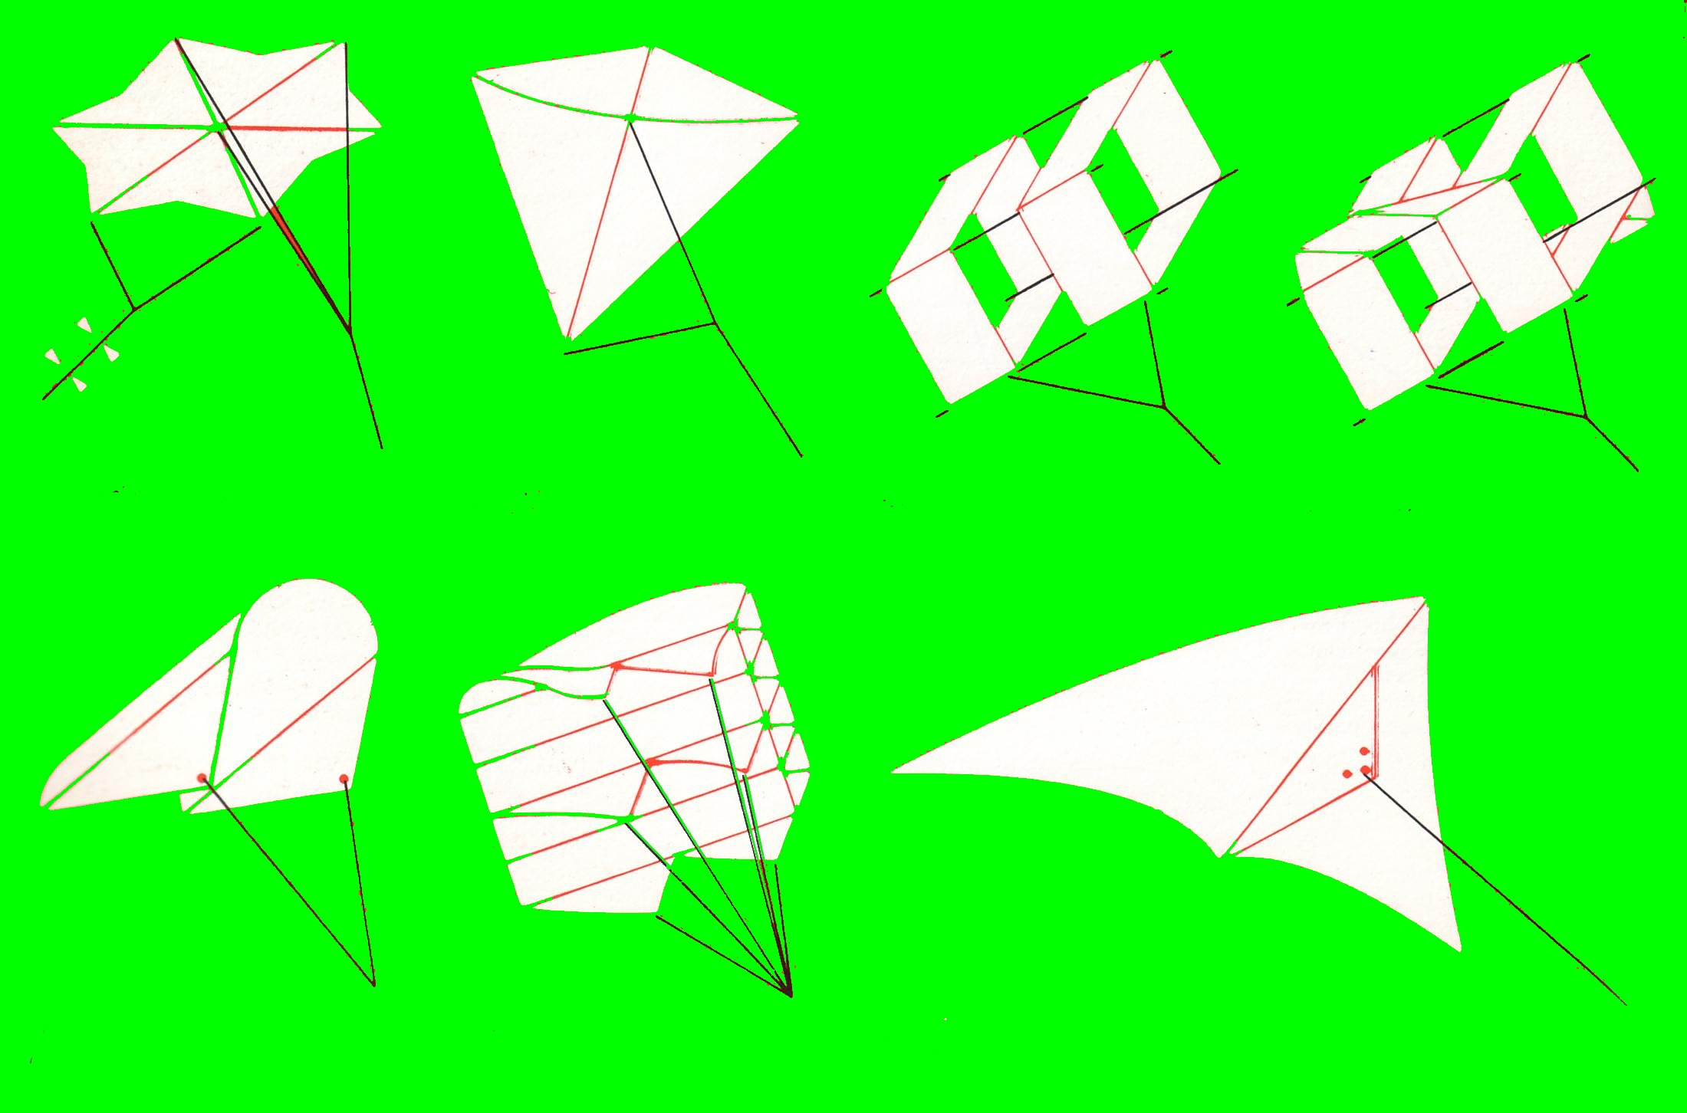
Notes:
Seven of these are :- flat; bowed; box; compound
sled; parafoil; delta.

Slide 13
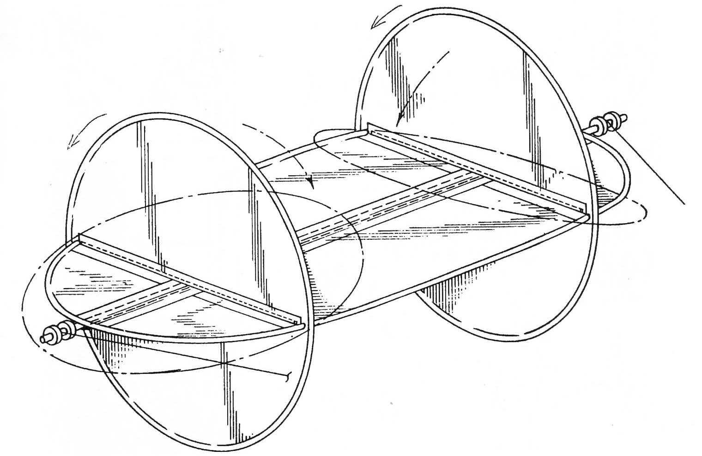
THE ROTOR
Notes:
The last is the rotor and the principals for this are rather different, the lift being generated by the rotation of the kite.

Slide 14
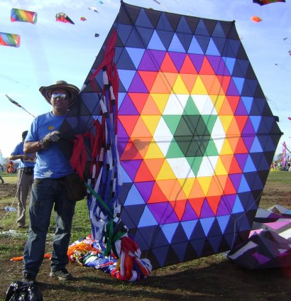
FLAT HEXAGON
Notes:
The tails for stabilising this kite can be seen hanging close to the flyer.

Slide 15
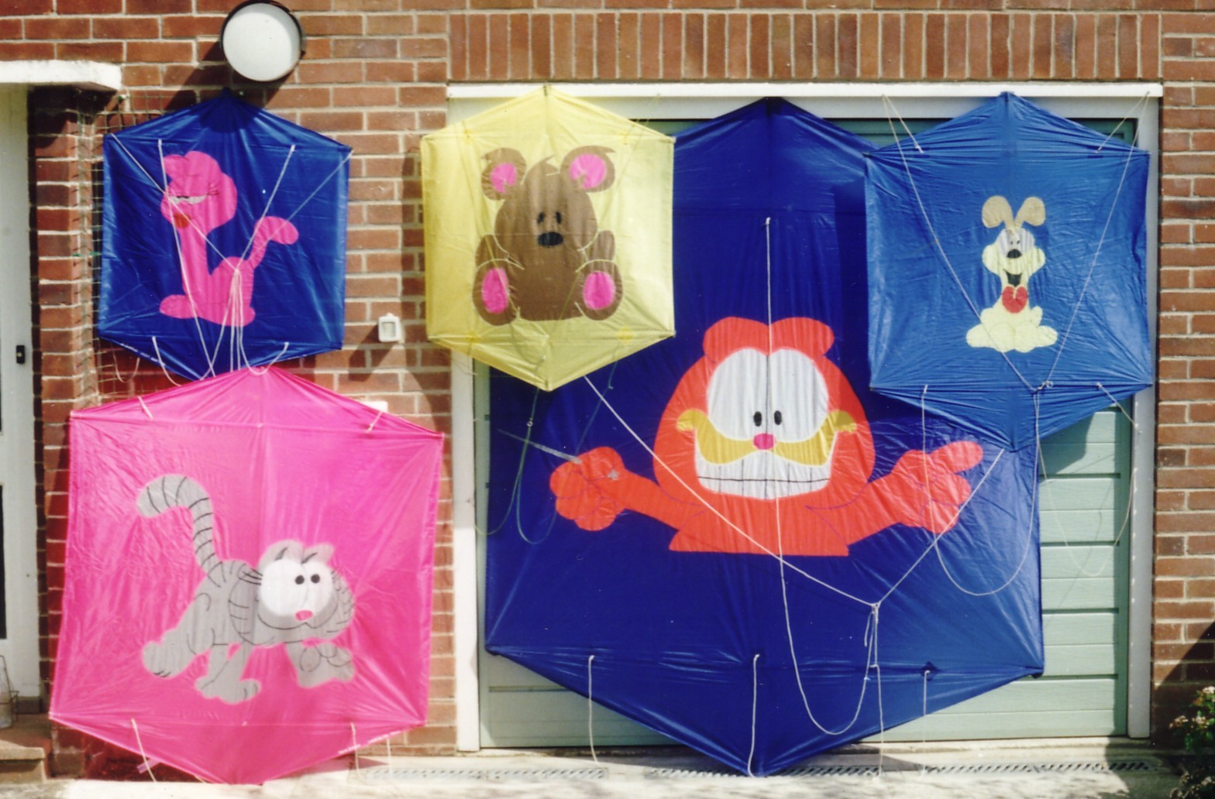
ROKAKKUS
Notes:
Rokakkus, meaning six sides, are a Japanese design and are a bowed kite. They can be any size from a few centimetres to 20 metres high and are used for fighting, sometimes with powdered glass or knives on the line.

Slide 16
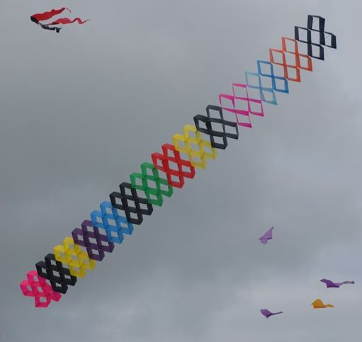
BOX KITES
Notes:
Box kites can be a simple single cell or multi celled like this one.

Slide 17
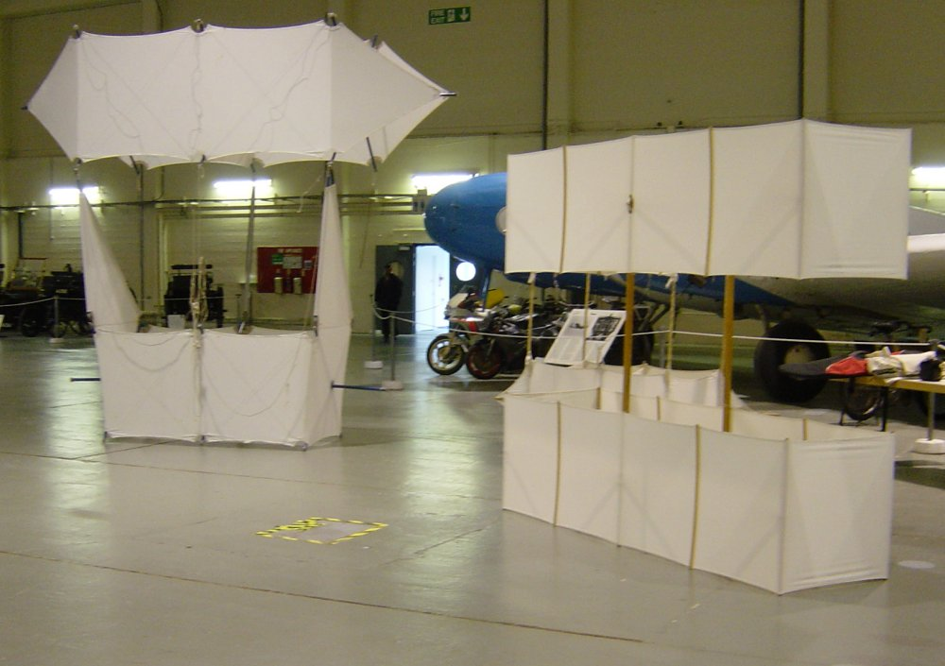
COMPOUND BOX KITES
Notes:
These are examples of large historic compound box kites made of cambric on spruce frames.

Slide 18
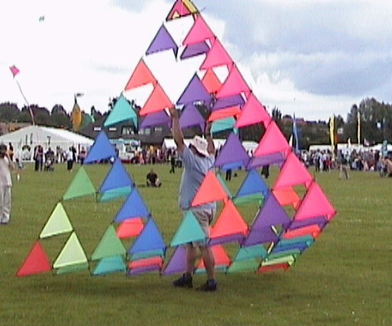
BELL TETRAHEDRAL
Notes:
Another form of box kite is the Bell tetrahedral. These are made up of many individual tetrahedrons combined in various ways. Alexander Graham Bell combined over 3000 units to make a man lifting kite whilst looking in to heavier than air flight.

Slide 19
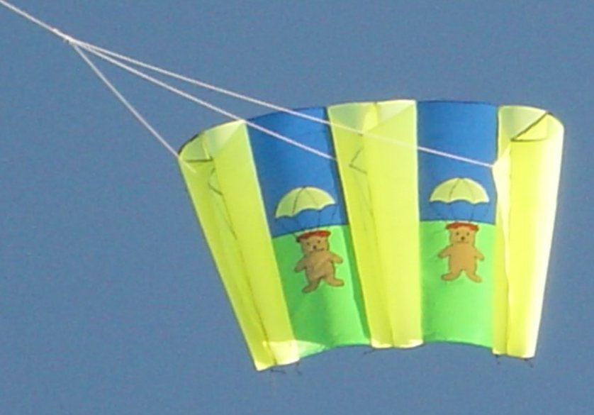
SLED KITE
Notes:
Sled kites only have spars runing front to back and none cross ways. This one uses the tubes that inflate in the wind to keep it open.

Slide 20
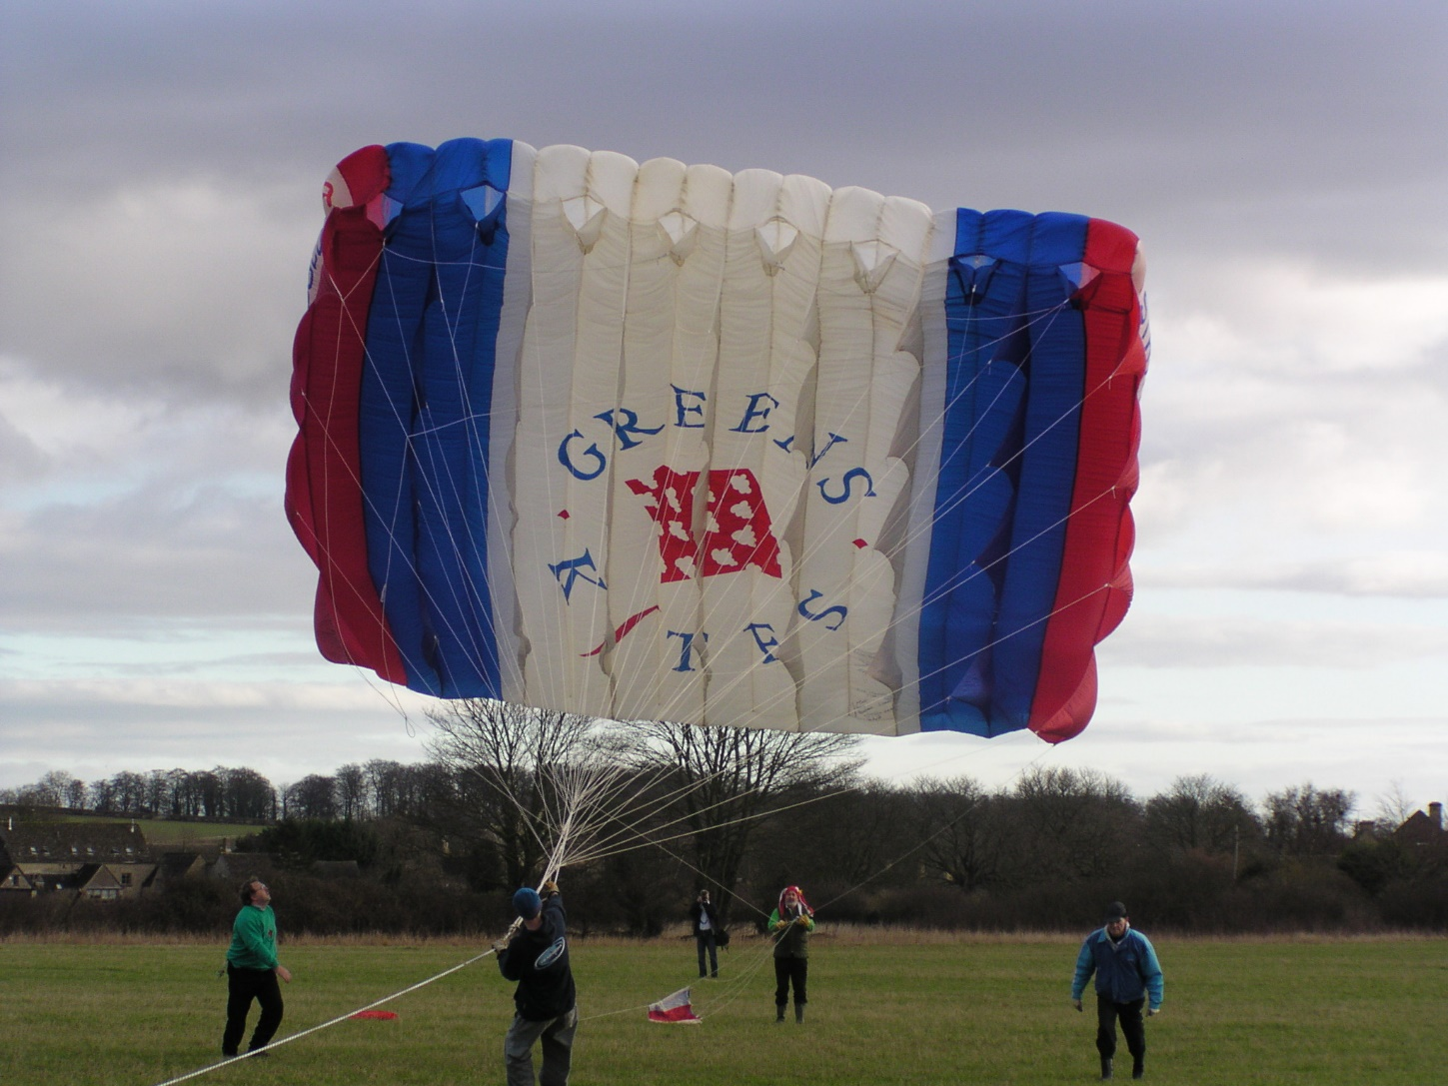
LARGE LIFTER
Notes:
This is an example of a very large parafoil kite. There are no spars and the kite is inflated by the wind through the vents in the front edge. Parafoils have an airofoil section and produce enormous amounts of lift.This one is about 65sqm and can lift about a tonne of the ground in a good wind.

Slide 21
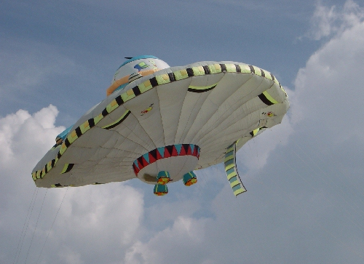
SOFT KITES
Notes:
This kite is inflated by the wind but is not aerofoil shaped but flies like flat kite.

Slide 22
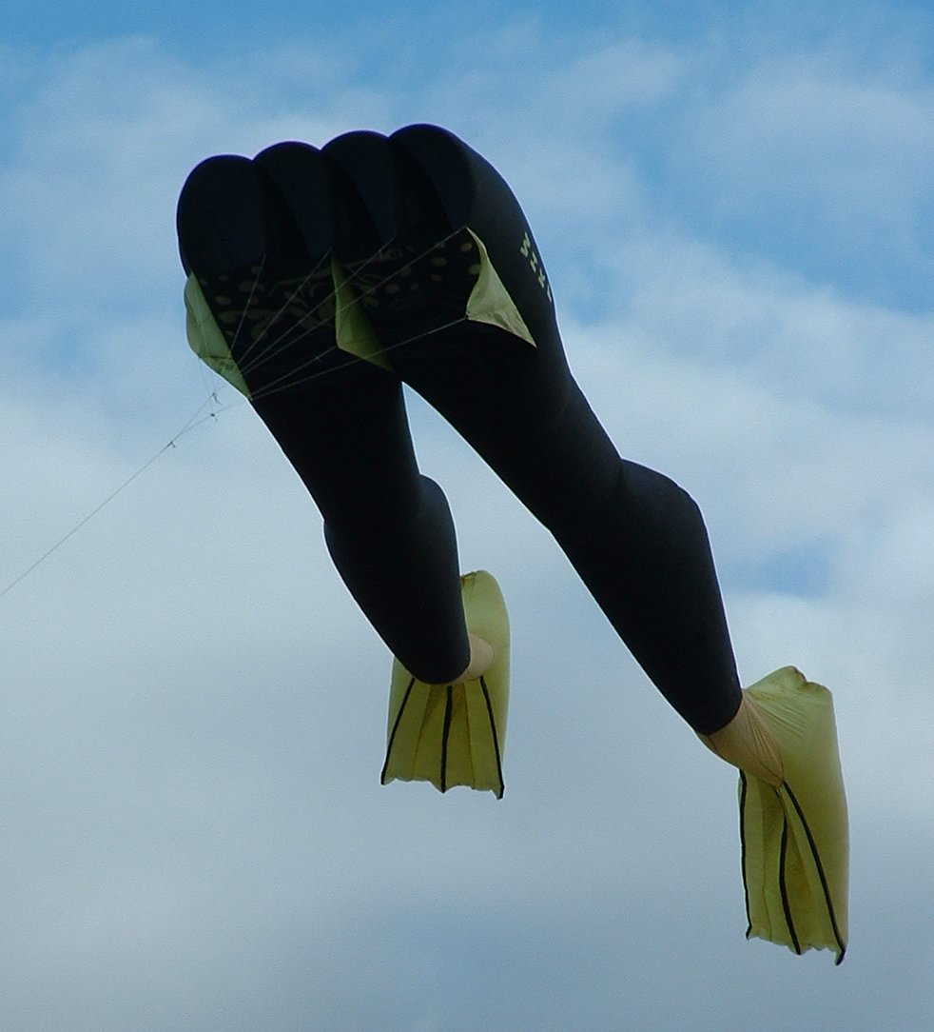
KITES TODAY
Notes:
The shorts of these legs is an aerofoil kite and the legs are wind socks attached to the back. There are vents in the end of the shorts and the flippers to assist air flow through kite.

Slide 23
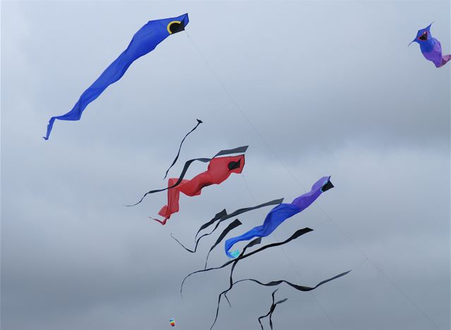
DELTA KITES
Notes:
A group of delta kites with added long tails. Deltas fly very well in lighter winds. Most deltas have a nose angle of 90deg. But by increasing this and making the kite much wider and narrower they can be made to fly in very light winds.

Slide 24
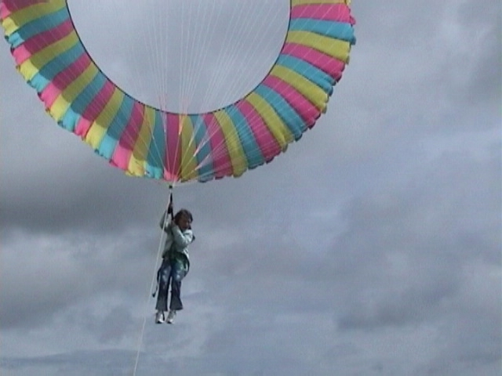
MAN LIFTING
Notes:
The bol is a form of rotor kite and although they fly at a relatively low angle they can develop good lift. Vents in the front edge make the kite spin and a good swivel has to be included in the line.

Slide 25
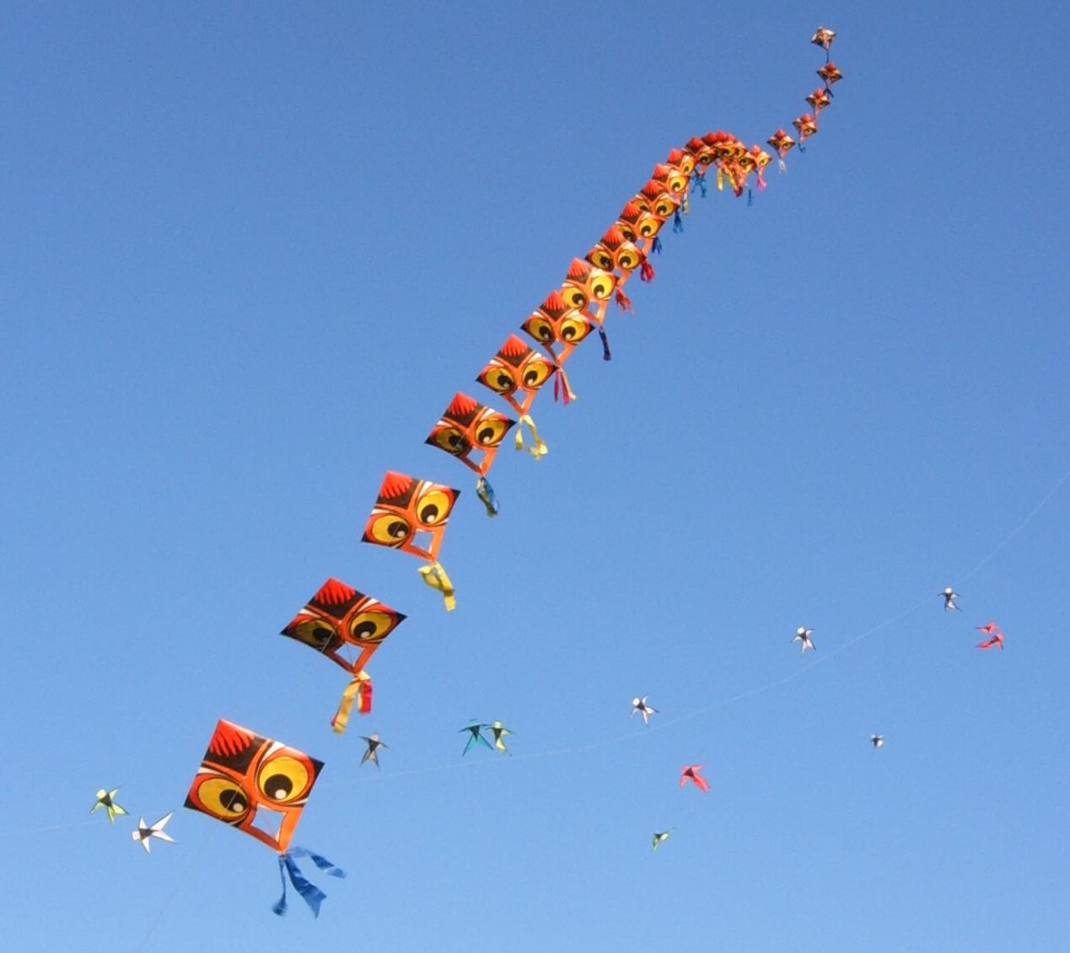
KITE TRAINS
Notes:
Kites may be mounted one behind the other on a single line. This is called a “train” and can pull very hard. The line will increase in size the more kites there are on it. The more distant kites in the lower part of this picture are also flying as a train but this time each is on it’s own short line attached to the main one. In China these are very popular and sometimes have many thousands of individual kites.

Slide 26
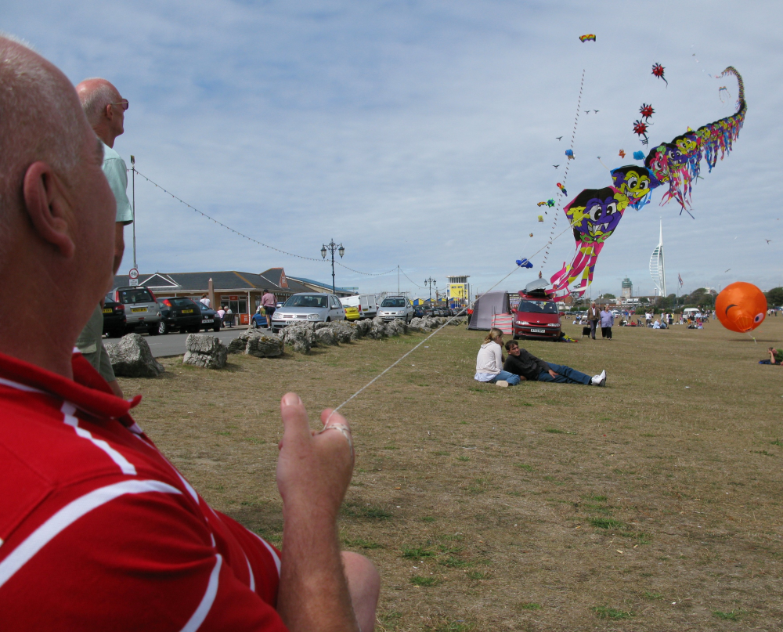
KITE TRAINS
Notes:
More examples of trains.

Slide 27
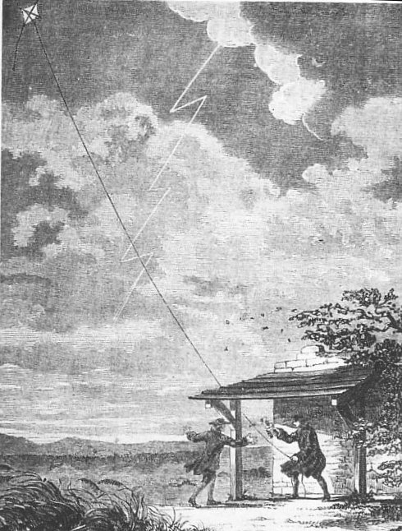
USES OF KITES
FRANKLIN’S LIGHTNING EXPERIMENTS
Notes:
Kites have long been used for lifting atmospheric monitoring instruments. By flying a kite in a thunder storm Benjamin Franklyn was able to prove that lightening was a form of electricity. Please do not try this as others were not so lucky and ended up being fried.

Slide 28
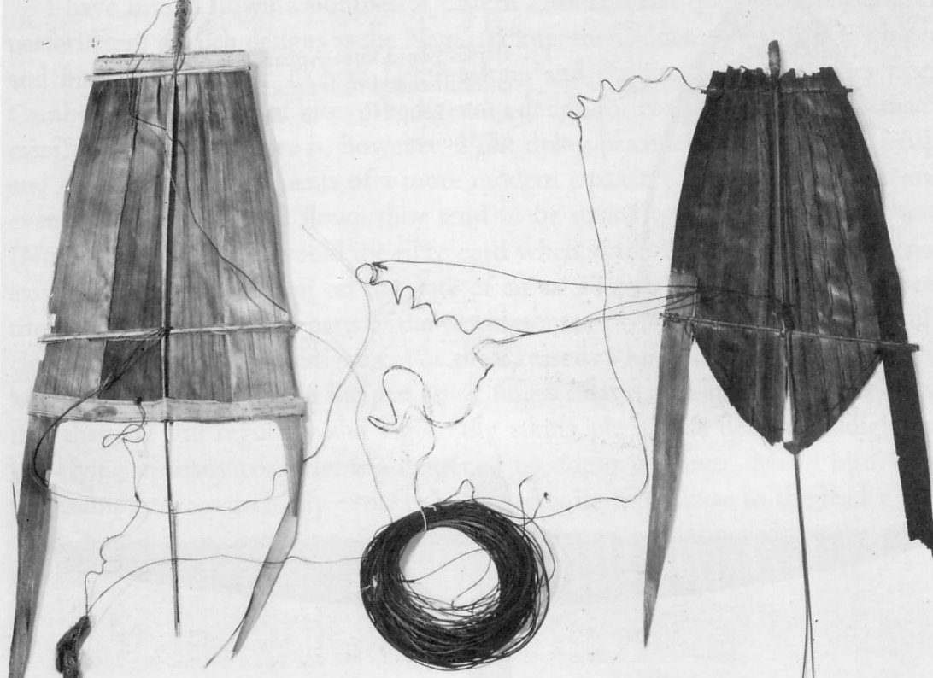
FISHING
THE SOLOMON ISLANDS
Notes:
Kites have long been used for fishing and these examples are made from leaves and are still used today in the Solomon Islands. A baited hook or lure is hung from the back of the kite that is then flown out across the water. This can be much easier than casting long distances with primative rods.

Slide 29
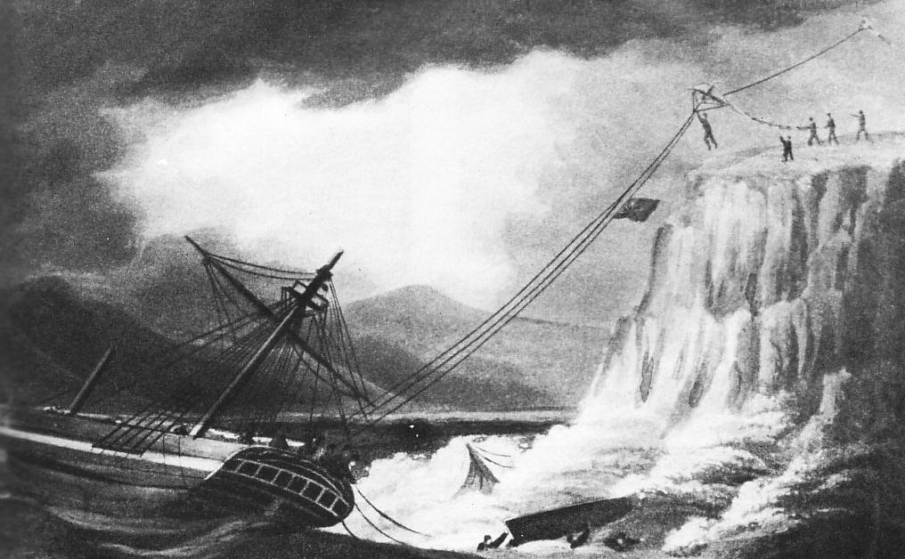
RESCUE
Notes:
Kites have been used in many ways for rescue at sea. Here a ship stranded on rocks would fly a kite with a light weight line up to the cliffs where rescuers would use this line to pull up a heavier one and then the crew could be pulled to safety.

Slide 30
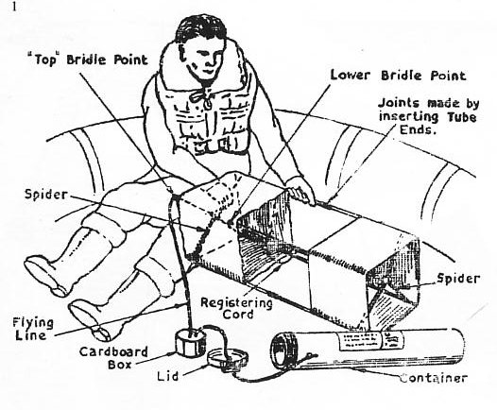
WW2 RESCUE
Notes:
In WW2 if your plane ditched at sea part of the equipment in the life raft was a radio transmitter and a kite was used to lift the aerial.

Slide 31
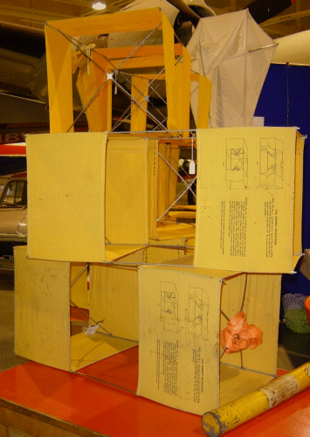
Notes:
These kites became available in army surplus stores after the war and many fliers today started with these. They are now a collectors item and can make several hundred pounds depending on which version you have.

Slide 32
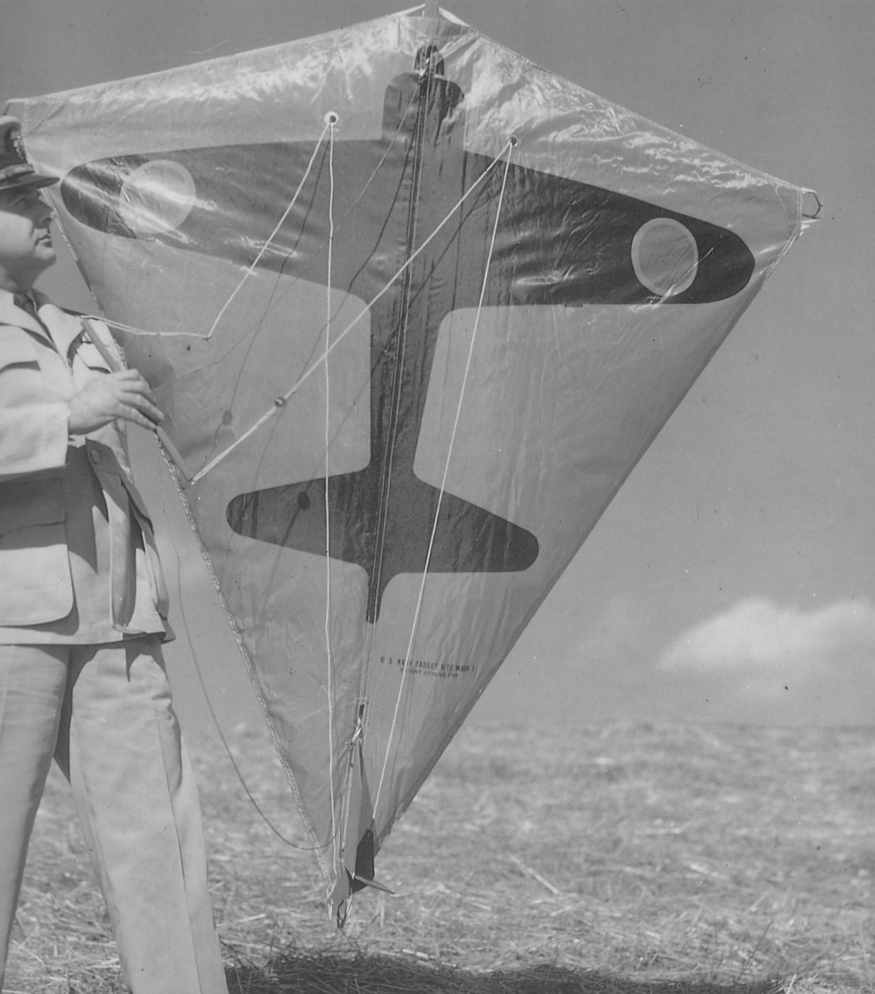
TARGET PRACTICE
PAUL GERBER
Notes:
Again in WW2 gunnery practice at moving targets was difficult and could be dangerous for pilots towing printed drogues. Paul Gerber designed a stearable kite that could be used instead. This was the fore runner of many of todays “stunt” kites.

Slide 33
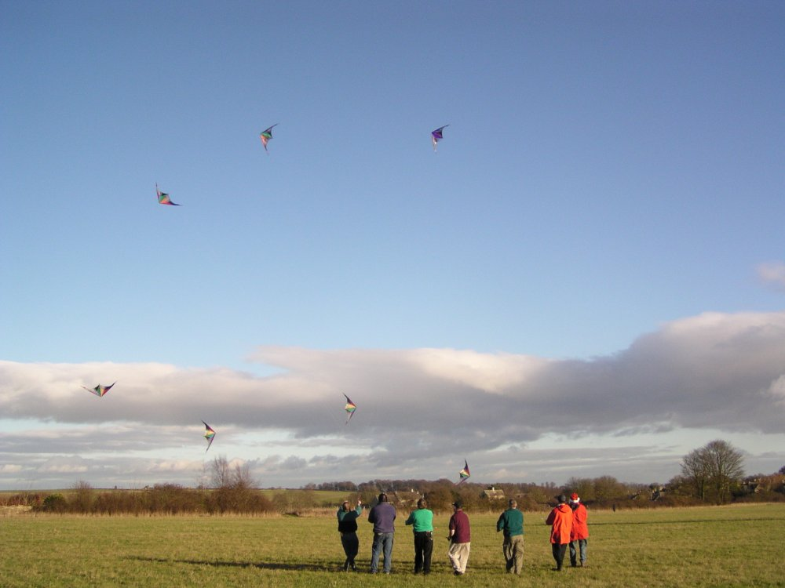
MODERN “STUNT” KITES being flown in formation

Slide 34
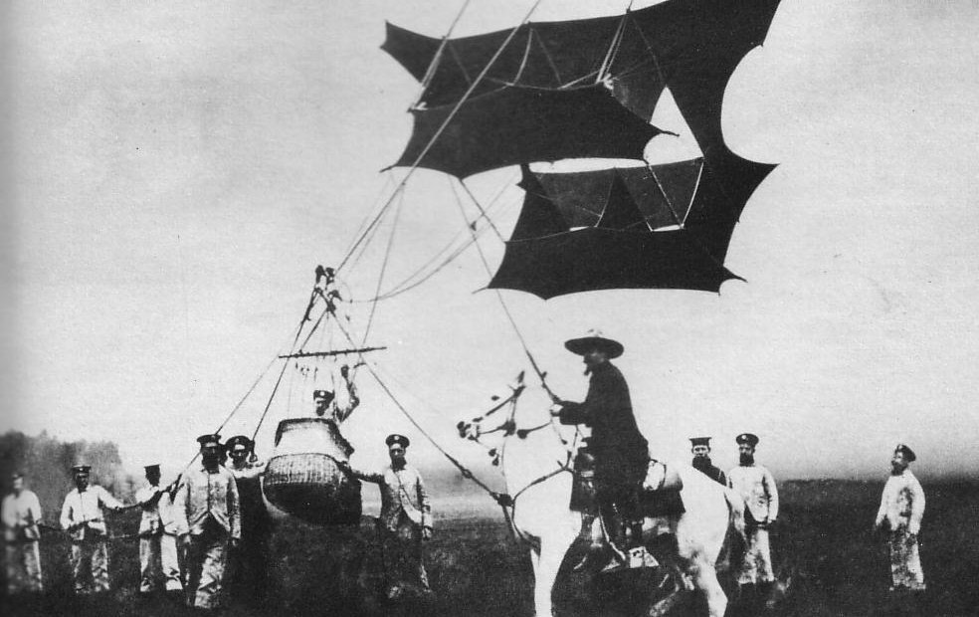
CODY MAN LIFTING
Notes:
At the beginning of the last century pioneers of heavier than air flight such as the Wright brothers used kite to establish that you could lift a man. Here we see Samuel Cody with his system.

Slide 35
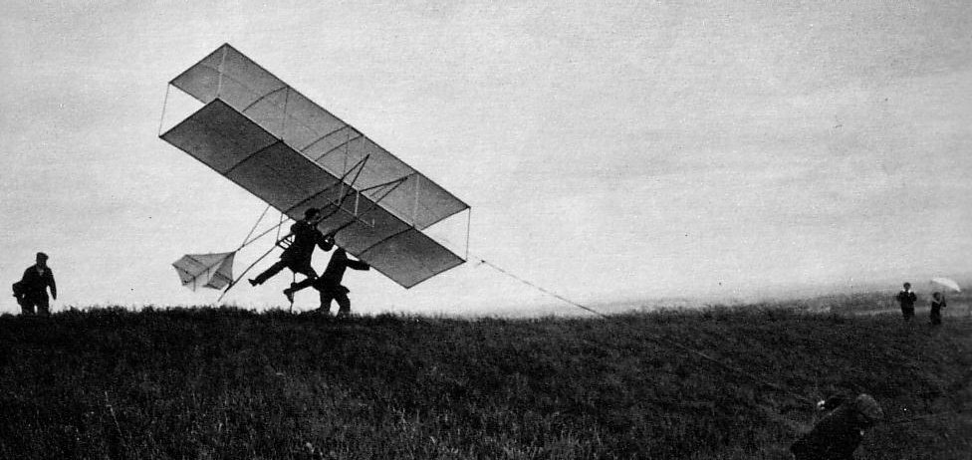
AVIATION DEVELOPMENT
Notes:
The next step was to change the shape of the kite and turn it in to a glider. An option pioneered 100 years earlier by sir George Caley

Slide 36
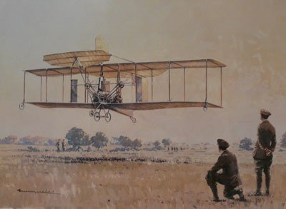
AVIATION DEVELOPMENT
Notes:
Then by adding a motor and propeller Samuel Cody built British Army Aeroplane No. 1 and in 1908 was the first person to make a powered flight in GB

Slide 37
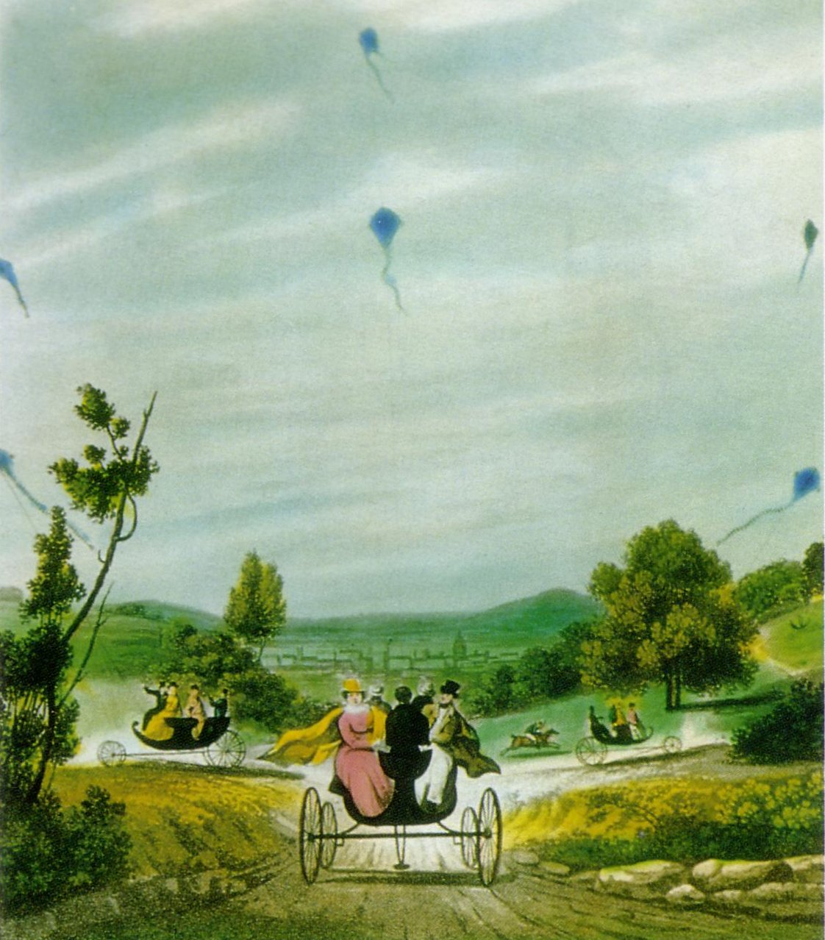
EARLY TRACTION
BY GEORGE POCOCK
Notes:
In about 1830 George Pocock, a teacher from Bristol designed a system that used kites to pull a light weight carriage. These could reach speeds of 25mph.

Slide 38
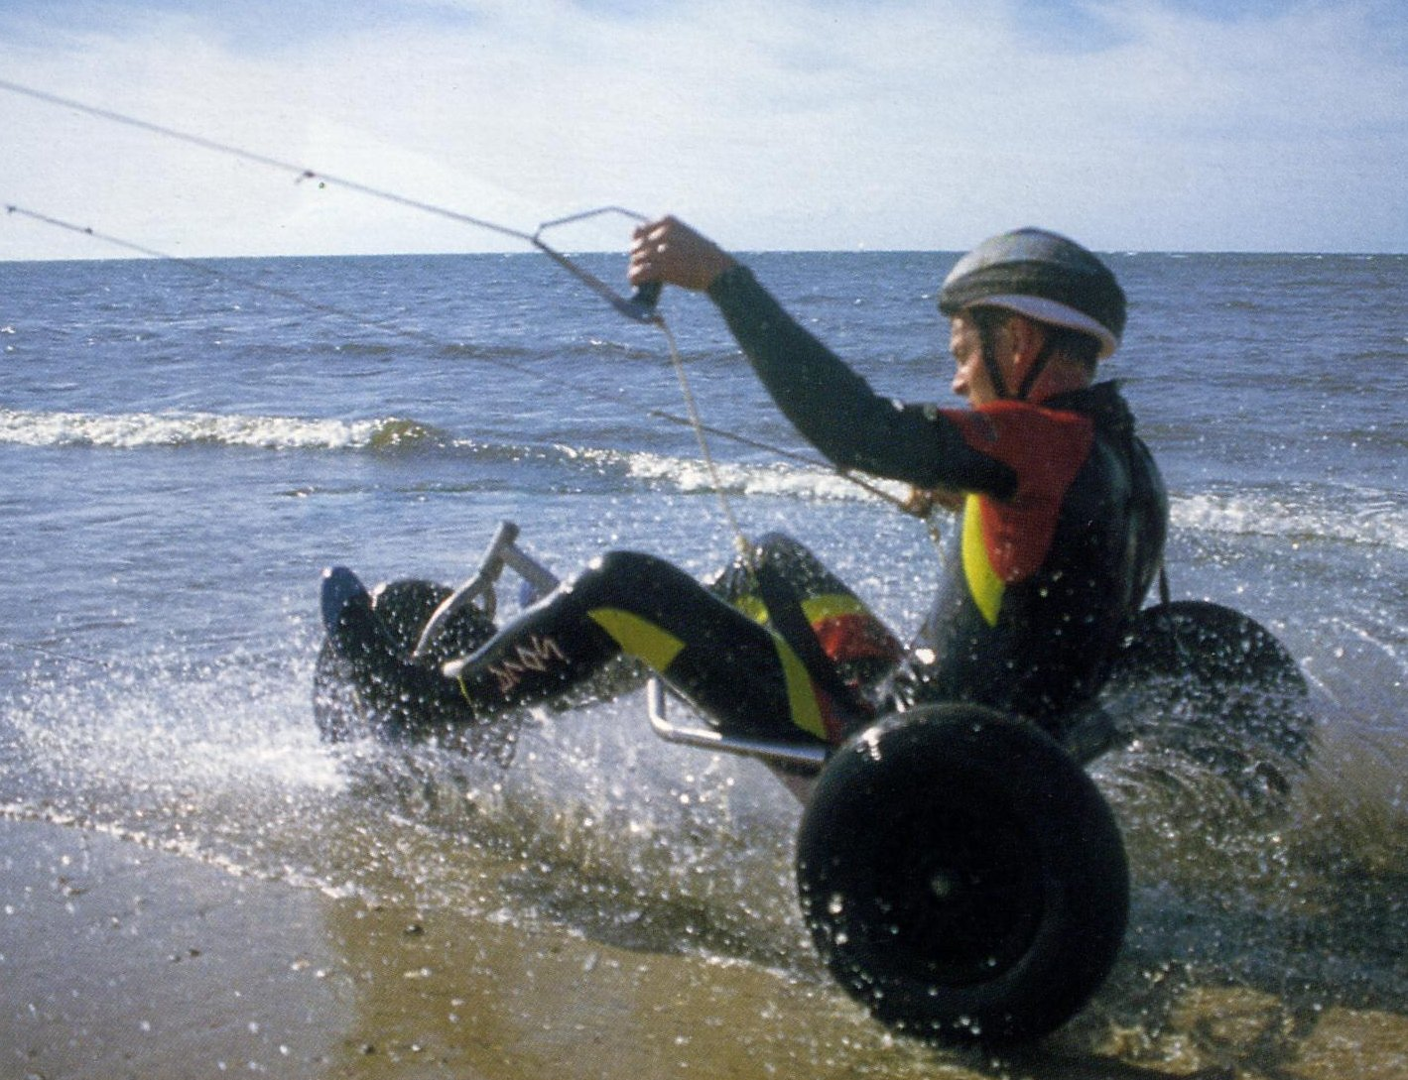
MODERN TRACTION
BY PETER LYNN
Notes:
The modern version used for pleasure reaching speeds of 80mph

Slide 39
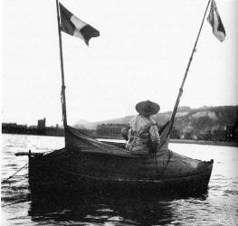
1ST KITE POWERED BOAT TO CROSS THE CHANNEL
BY Samuel Cody 1903
Notes:
Kite powered boats were also tried by both Pocock and Cody the latter making a kite powered channel crossing in 1903.

Slide 40
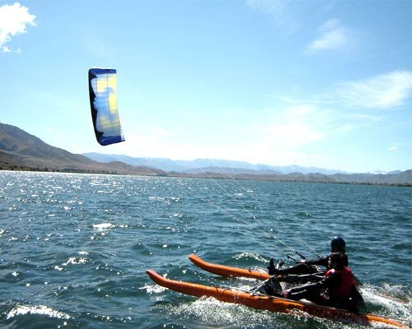
A MODERN KITE POWERED BOAT
Notes:
A 21st century kite powered boat.

Slide 41
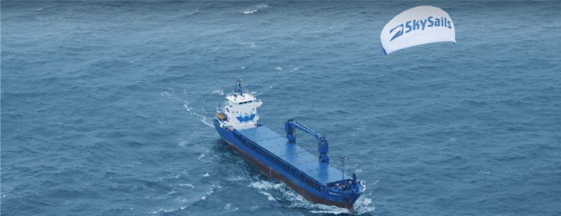
A COMMERCIAL APPLICATION
Notes:
Kite power is now being used on much larger boats and in 2010 the Beluga Skysail was used to assist a freighter cross the Atlantic with a fuel saving of about 30%. This research is ongoing.

Slide 42
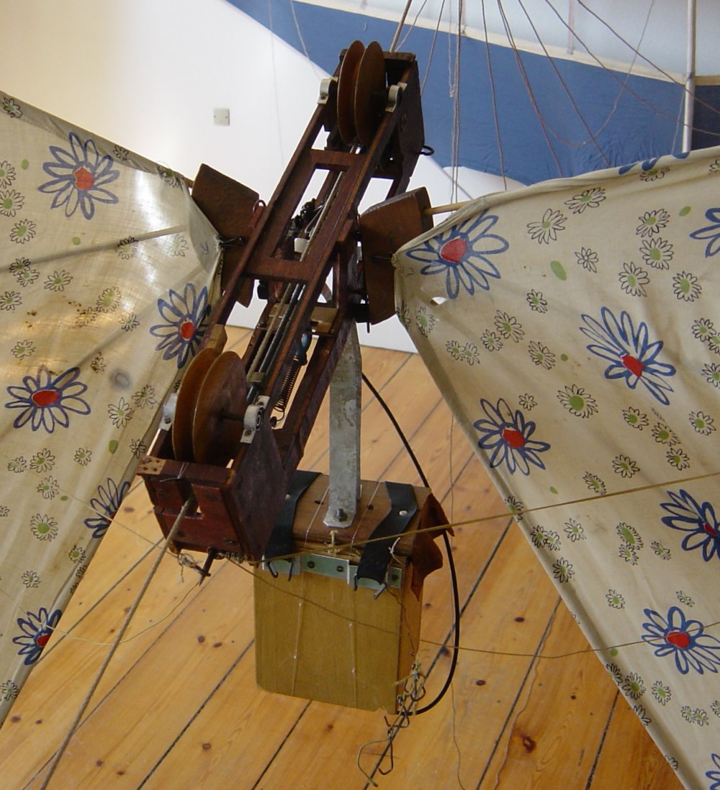
PHOTOGRAPHY
THE OLD
Notes:
As we have seen earlier kites can be used for lifting atmospheric instruments. This is an old method of taking aerial photographs. The sails at the sides were used to carry the camera up the kite line to a preset height when it would take a picture and the sails fold down returning the camera to the where it could have a new plate fitted for another shot.

Slide 43
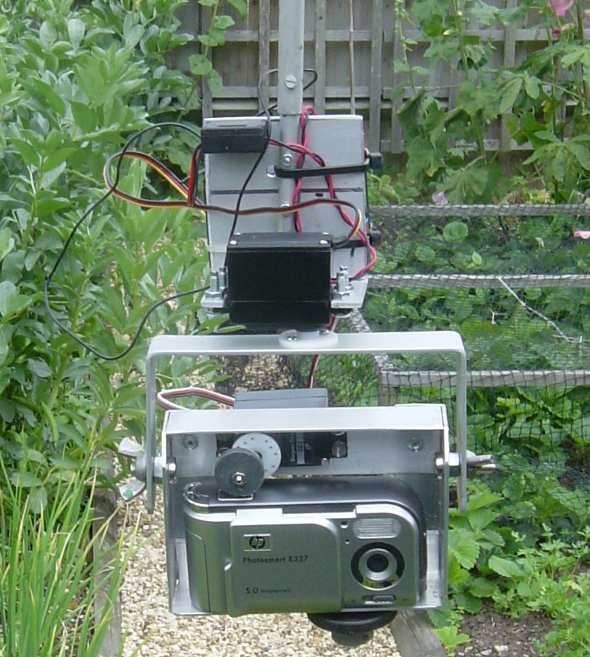
PHOTOGRAPHY
THE NEW
Notes:
A modern equivalent system using a digital camera and radio control to change angles and release the shutter.

Slide 44
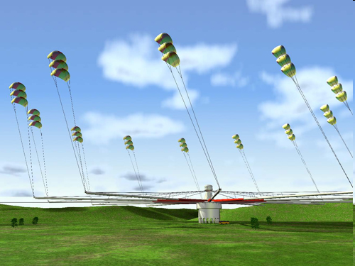
POWER GENERATION
Notes:
One of the most exiting developments in kites at the moment is the possibility of generating electricity. A series of computer controlled kites are connected to a generator at ground level and flown in the high speed winds at altitudes above 300m.

Slide 45
WARNINGS
Always fly safely
Always be considerate to other people using the same area whether it is noise or physical intrusion into their space.
Never fly at a height of more than 60 metres above ground level unless a CAA clearance is in force (as at kite festivals). If you don’t know what the clearance is ASK!
Never fly a kite in wet or stormy weather. Always try and keep your line dry.
Never fly a kite near power lines, transmission towers or aerials.
Never fly near Motorways, roads, car parks or railways.
Never fly near airfields. The maximum height limit in any area of restricted air space is 30 metres.
Never have any metal in the flying line and do not attach anything sharp to the line.
Always make sure that you use an adequate anchor for large kites and never leave them unattended.
Always wear strong gloves when flying large kites.
Always give priority to domestic animals particularly if they are showing signs of distress.
Always clear up after yourself, especially lines, tails and bits of plastic that could trap, choke or injure domestic animals.
Never fly near those kite-eating trees.
Finally remember…..your kites can get really quite lonely up high in the sky; just occasionally, look up and give them a SMILE. It will make you feel better too.

Slide 46
If you want to see more
Please come to
our monthly fly-in,
Second Sunday every month
at
Barbury Castle near Swindon
www.whkf.org.uk

Slide 47
That’s all folks thank you for you attention

